Slide 1

Parkway Christian Academy
A Primer for Families
Notes:
An Education Savings Account (ESA) provides parents of students in non-public Texas schools a publicly-funded, government-authorized savings account with restricted, but multiple, uses for their children’s education.
The Texas Catholic Conference of Bishops Education Department is overseeing ESA implementation in Catholic schools and will be a guiding hand for parents and schools as they navigate the process.

Slide 2

Texas Educational Freedom Accounts (TEFAs)
SB2 became law Sept. 1
Provides $1B for approx. 70,000 students
Per student, annually:
Student enrolled in an eligible school: $10,500 - $12,000
A child with a disability: up to $30,000
Home-schooled participants: $2,000
Notes:
How much money is available?
The state has budgeted $1 billion, which will serve approximately 90,000 students – but given that amounts vary between $2,000 and 30,000 the total number of students who receive ESAs is hard to predict.
How much is each student eligible to receive?
Participants choosing an accredited private or Catholic school receive 85% of the estimated statewide average amount of state and local funding per student for the most recent school year, which was calculated at $10,500 but with the implementation of HB 2, that number is likely to go up to 12,000 or higher. A child with a disability may receive up to $30,000, according to the amount the child’s school district would receive if the child were enrolled in public school, based on the child’s individualized education program (IEP).
Home-schooled participants receive $2,000.

Slide 3
Eligible expenses include:
School tuition
Tutoring
Online education programs
Therapies for students with special needs
Textbooks or other instructional materials
Uniforms
School breakfast and lunch at private schools
Don’t Forget Vendors
Notes:
What are approved expenses?
Tuition and fees for a private school, higher ed provider, online educational course or program, or a program that provides industry-based credential approved by TEA.
Purchase of instructional materials or uniforms.
Fees for classes provided by a public school.
Costs related to academic assessments.
Fees for private tutor or teaching service.
Fees for transportation provided by a fee-for-service transportation provider.
Fees for educational therapies or services not covered by government benefits or private insurance.
Costs of computer hardware and software and other technological devices required by a provider or prescribed by a physician (not to exceed in any year 10% of the total amount in the child’s ESA for the year).
Costs of breakfast or lunch provided during the school day by a private school.
Money may not be used to pay any person related to a program participant within the third degree of consanguinity.

Slide 4
Approved providers or vendors
Accredited by TEPSAC or TEA
Annually administer a nationally-norm-referenced assessment for TEFA participants Grades 3-12 (IOWA test)
Continuously operated a campus for at least two school years preceding participation in TESA program
Financial review or audit per accreditation rules
Notes:
A private school accredited by TEPSAC or TEA and annually administers a nationally norm-referenced assessment in grades 3-12 and has continuously operated a campus for at least two school years preceding the date the school seeks approval to participate in the program
ALSO approved vendors/providers:
A provider of supplemental special education services previously approved by TEA.
A school district or charter school accredited by TEA and able to provide services or products to participating children in a manner that the children are not counted toward average daily attendance.
A qualified private tutor, therapist, or teaching service employee.
A higher education provider that demonstrates nationally recognized postsecondary education accreditation.

Slide 5
Autonomy
An education service provider or vendor (PWCA) who receives TEFA money is not a recipient of federal financial assistance and may not be considered a state actor.
The state may not impose limits or requirements contrary to religious or institutional values of a provider, vendor, or participant regarding curriculum, admissions practices, operations, policies, standards, etc.
Notes:
An education service provider or vendor who receives ESA money is not a recipient of federal financial assistance and may not be considered a state actor.
The state may not impose limits or requirements contrary to religious or institutional values of a provider, vendor, or participant regarding curriculum, admissions practices, operations, policies, standards, etc.

Slide 6
Eligible students:
Student must be a U.S. citizen, national, or lawful resident eligible to attend a Texas public school.
Priority for children from low-income families and with special learning needs.
Siblings are approved together; family does not have to reapply each year.
Notes:
Although all students meeting the above criteria are eligible (including those attending Catholic schools or home schooled) the law prioritizes children from low-income families and children with special learning needs.
Students attending public schools or charter schools full time are not eligible for ESAs.If a student is approved, so is the student’s sibling(s) who applied.
Once a family is approved and receives an ESA, they do not need to reapply each year. Their account will remain active as long as they continue to meet the program’s requirements. Unused funds may roll over year to year with no rollover limit while the student participates in the program.
Pastoral Responses to Mixed Status Families Regarding ESAs
The bill requires that the students have proper legal status to be in the United States. This means that citizen children of undocumented parents are eligible to attend. However, in the present immigration enforcement environment, it may not be prudent for these families to apply because the income verification will likely be done with the social security numbers of the parents. The state has asked public universities to identify undocumented students because of the lawsuit prohibiting in-state tuition for undocumented students. Mixed status families may be putting their families at risk by applying for the program. It's important that our schools and pastors are prepared to have conversations with parishioners about the risks of applying and other financial assistance options that may be safer for their families. We will work on some additional talking points as a part of our ESA implementation efforts that you can share with your pastors and school leaders.

Slide 7
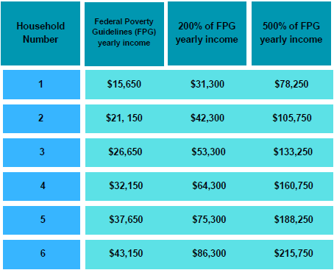
Prioritization
Children with disabilities whose family income is equal or less than 500% of FPG.
Families with income 200% or less than FPG.
Family income between 200-500% of FPG.
All others. Within this group:
Priority for students coming from public schools
Capped at 20% of total
Lottery in Each Category
Notes:
If applications exceed the limited number of available ESAs, ESAs will be allocated by lottery.
Priority group 1 – children with disabilities whose family income is equal or less than 500% of Federal Poverty Guidelines (FPG) (FPG in 2025 for a family of four is $32,150. See aspe.hhs.gov/poverty for more information.)
Priority group 2 – children whose family income is equal or less than 200% of poverty guidelines
Priority group 3 – children whose family income is between 200% and 500% of poverty guidelines
Priority group 4 – all other eligible children. Within this group students moving from public schools are prioritized. Also, funding for group 4 is capped at 20% of the total appropriation in the ESA program.

Slide 8
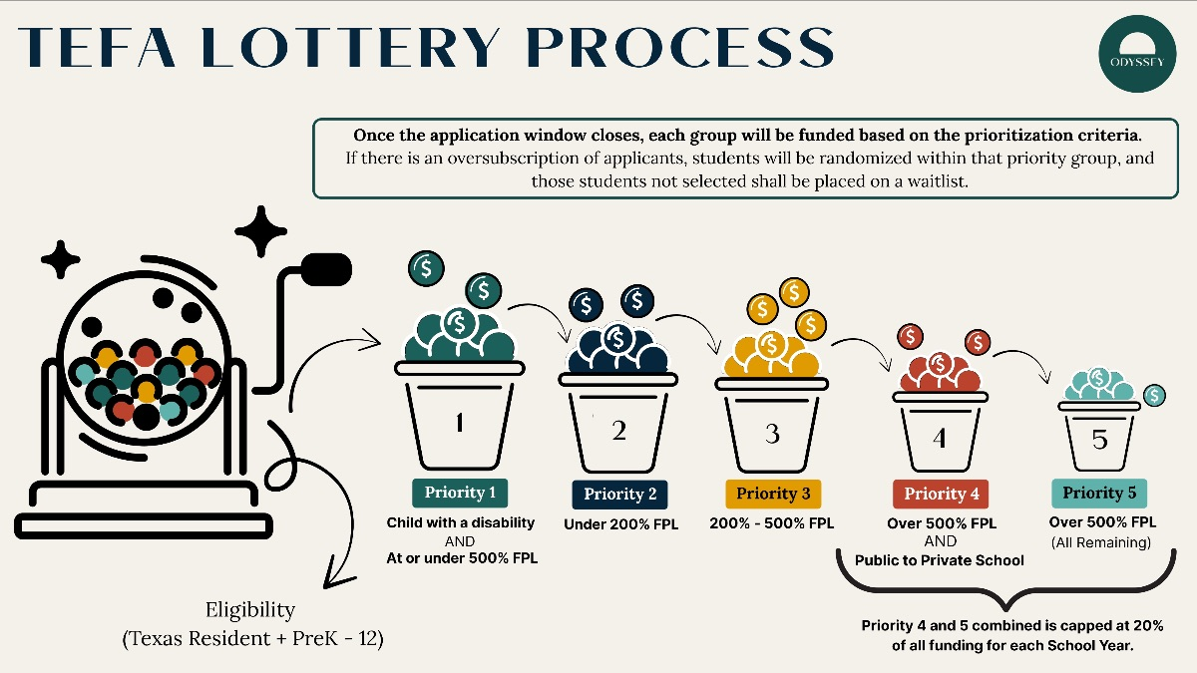
Graphic from Odyssey explaining the process:

Slide 9
Transferring from public school
Parents can obtain records
School district, TEA or charter school must verify child’s eligibility to Odyssey, the program administrator.
Odyssey must comply with confidentiality laws and timelines.
Notes:
A public school must provide records to the parent of a child seeking to participate in the ESA program or to a private school at the parent’s request. A school district, TEA, or charter school must provide information to the CEAO to verify a child’s eligibility to participate in the ESA program. The CEAO may not retain information beyond the period necessary to determine eligibility and it must comply with confidentiality laws and may not sell or distribute information without a participant’s consent.

Slide 10
Parents required to:
Spend program money only for eligible expenses
1
Share child's assessment results with Odyssey
2
Not sell an item purchased with program money and
3
Notify the EAO with in 30 days of child enrolling in public school, graduating high school, or otherwise becoming ineligible to enroll in public school.
4
Notes:
What is required of parents?
Parents must agree to:
Spend program money only for eligible expenses
Share child's assessment results with EAO
Not sell an item purchased with program money and
Notify the EAO with in 30 days of child enrolling in public school, graduating high school, or otherwise becoming ineligible to enroll in public school.

Slide 11

Child with disabilities
1. Is not more than 21 years of age and has a visual or auditory impairment that prevents the student from being adequately or safely educated in public school without the provision of special services; OR
2. Is at least three but not more than 21 years of age and has one or more of the following disabilities that prevents the student from being adequately or safely educated in public school without the provision of special services:
physical disability;
intellectual or developmental disability;
emotional disturbance;
learning disability including dyslexia;
autism;
speech disability; or
traumatic brain injury.
ADD/ADHD (affecting academics)
Private Evaluation by Medical Doctor OR ISD IEP by January to qualify for prioritization
Notes:
A “child with a disability,” as defined by the State of Texas:
1. Is not more than 21 years of age and has a visual or auditory impairment that prevents the student from being adequately or safely educated in public school without the provision of special services; OR
2. Is at least three but not more than 21 years of age and has one or more of the following disabilities that prevents the student from being adequately or safely educated in public school without the provision of special services:
physical disability;
intellectual or developmental disability;
emotional disturbance;
learning disability;
autism;
speech disability; or
traumatic brain injury.

Slide 12
Requirements for children with disabilities
The parent of a child not enrolled in public school may request a school district to provide an evaluation and to develop an IEP for the child.
Odyssey must provide notice to parents regarding how federal and state laws regarding the provision of educational services to a child with a disability in apply differently for private schools, versus public.
Odyssey must provide information regarding the rights to which a child with a disability is entitled if the child attends a public school.
MUST Have ISD IEP by January to qualify for additional funding
Notes:
The parent of a child not enrolled in public school may request a school district evaluate a child for determining eligibility for special education services and participation in the ESA program as a child with a disability. If the child is eligible, the school district must develop an Individualized Education Program (IEP) for the child.
The certified education assistance organization (CEAO) must provide notice to parents that a private school is not subject to federal and state laws regarding the provision of educational services to a child with a disability in the same manner as a public school.
The CEAO must provide information regarding the rights to which a child with a disability is entitled if the child attends a public school.

Slide 13

Let’s get started!
October 2025: Odyssey announced as program adminstrator
Fall 2025: TCCB-ED & TPSA host additional trainings based on rules
Early 2026: The application process is expected to open.
School year 26-27: When money in TEFAs can first be used for eligible expenses.

